Slide 1
SQL Brainteasers
Siddharth Kaul
Akshay Mahale
Vivek Shingate
Date : 03/31/2016

Slide 2
Table of Contents
Inserting values into identity Column
Identifying the removed number in the column containing sequence of numbers
Finding rows and Column sum
NULL v/s Blank
Converting rows to Columns
Converting Columns to rows
Deleting duplicate records

Slide 3
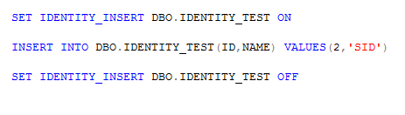
Inserting values to Identity Column
While Inserting data into identity Column , we get the below error :
Solution

Slide 4
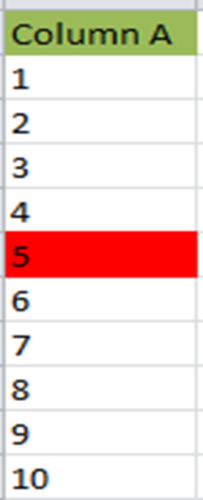

Identifying the removed number in the column containing sequence of numbers
Column A
1
2
3
4
5
6
7
8
9
10
Column A
1
2
3
4
6
7
8
9
10

Slide 5

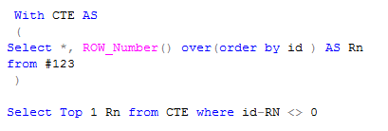
Identifying the removed number in the column containing sequence of numbers
Solution 1
Solution 2

Slide 6
Finding rows and Column sum
INPUT TABLE
Output table
Num1 | Num2 | Num3
10 | 20 | 30
40 | 50 | 60
70 | 80 | 90
Rn | Num1 | Num2 | Num3 | ColumnSum
1 | 10 | 20 | 30 | 60
2 | 40 | 50 | 60 | 150
3 | 70 | 80 | 90 | 240
Total | 120 | 150 | 180 | ColumnSum

Slide 7
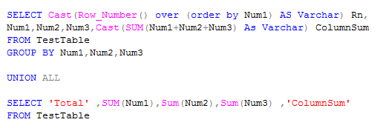
Finding rows and Column sum
SQL query :

Slide 8
Null v/s Blank
Table tbl1 Table tbl2
ID 1
1
1
1
NULL
NULL
‘’
ID 2
1
1
NULL
‘’

Slide 9
Null v/s Blank
Inner Join Left Join
ID 1 | ID 2
1 | 1
1 | 1
1 | 1
1 | 1
1 | 1
1 | 1
‘’ | ‘’
ID 1 | ID 2
1 | 1
1 | 1
1 | 1
1 | 1
1 | 1
1 | 1
NULL | NULL
NULL | NULL
‘’ | ‘’

Slide 10
Null v/s Blank
Right Join Full OuterJoin
ID 1 | ID 2
1 | 1
1 | 1
1 | 1
1 | 1
1 | 1
1 | 1
NULL | NULL
NULL | NULL
‘’ | ‘’
NULL | NULL
ID 1 | ID 2
1 | 1
1 | 1
1 | 1
1 | 1
1 | 1
1 | 1
‘’ | ‘’
NULL | NULL

Slide 11

Null v/s Blank
Calculation of Average
Output : 20
ID
10
20
30
NULL
0

Slide 12

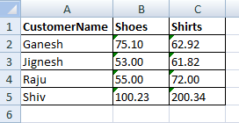
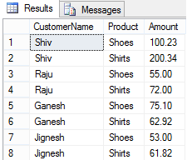
Converting rows to columns

Slide 13
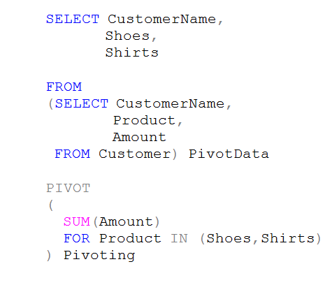
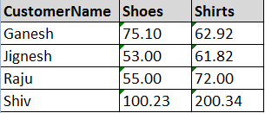
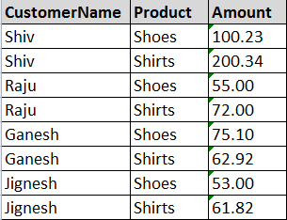
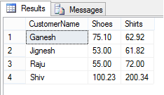
Converting rows to columns
Query :
1
2
Actual Data
3
Actual Pivoting
Output :

Slide 14
Converting columns to rows

Slide 15
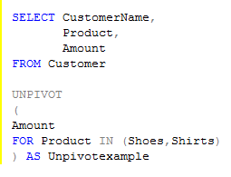

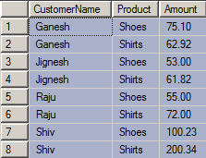
Converting columns to rows
Query :
1
Desired output
columns
2
Unpivoting
operation
Output :

Slide 16
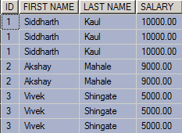

Deleting duplicate records
All duplicate records should be deleted except one.

Slide 17
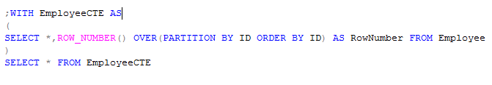
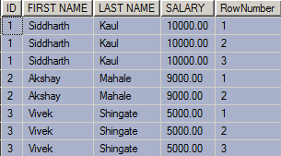
Deleting duplicate records

Slide 18
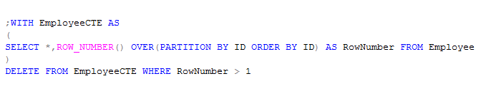
Deleting duplicate records

